Slide 1
Advanced Cascading Styling Sheet (Layouts)
Web Design and Development

Slide 2
Block, Inline Layouts & Floats
Advanced Cascading Styling Sheet (CSS)

Slide 3
Block and Inline Layouts
Block elements:
Take up the full width of their container and stack vertically (e.g., <div>, <p>).
Inline elements:
Take up only as much space as their content and flow horizontally (e.g., <span>, <a>).

Slide 4
Floats
Used to position elements to the left or right of their container
Allowing text and inline elements to wrap around them
It was commonly used for creating column-based layouts before Flexbox and Grid were introduced,
But, it's now mainly used for specific tasks like floating images within text
.float-left {
float: left;
width: 200px;
margin: 10px;
}
<img src="image.jpg" class="float-left" alt="An image">
<p>This text will wrap around the floated image.</p>

Slide 5
Positioning
Advanced Cascading Styling Sheet (CSS)

Slide 6
Positioning
Controls the way elements are displayed and arranged
Understanding of these helps in organizing content meaningfully and responsively
There are five positioning types,
Static Positioning
Relative Positioning
Absolute Positioning
Fixed Positioning
Sticky Positioning

Slide 7
1. Static Positioning (default)
What is it?
This is the default position of every element in HTML. If you don't specify a position, it's considered "static."
How it behaves?
Elements with static positioning are placed one after another as they appear in the document (normal flow). You cannot control their exact position using top, right, bottom, or left properties.
<div style="position: static;">I am a static element</div>
Use Case:
Useful when you don’t need to move the element, and you want it to stay in the natural flow of the page.

Slide 8
2. Relative Positioning
What is it?
An element is positioned relative to its original position. You can use top, left, right, and bottom to move it, but it will still take up space in its original place
How it behaves?
Even though you can shift the element, its original position remains in the document flow
Use Case:
Useful when you need to slightly move an element but keep it occupying its original space
.relative {
position: relative;
top: 20px; /* Move 20px down */
left: 10px; /* Move 10px right */
}
<div class=“relative”>I moved from my original position</div>

Slide 9
3. Absolute Positioning
What is it?
The element is positioned relative to its nearest positioned ancestor (the closest parent element with position other than static).
If there’s no positioned ancestor, it will be placed relative to the HTML document itself.
How it behaves?
The element is removed from the normal flow, meaning it won’t affect other elements around it.
You can place it anywhere using top, left, right, and bottom.
Use Case:
Perfect for creating pop-ups, dropdowns, or elements that don’t need to take up space in the document flow.
.absolute {
position: absolute;
top: 50px; /* Place 50px from the top of its nearest ancestor */
left: 100px; /* Place 100px from the left of its nearest ancestor */
}
<div class=“absolute”>I am absolutely positioned</div>

Slide 10
Absolute VS Relative
Absolute positioning depends on the parent.
It positions an element relative to the nearest positioned ancestor (with relative, absolute, fixed, or sticky).
If no such ancestor exists, it's positioned relative to the document.
Relative positioning doesn't depend on the parent.
It moves the element relative to its own position without affecting its surroundings.
Summary,
Absolute positioning depends on the parent.
Relative positioning moves the element without depending on the parent.

Slide 11
4. Fixed Positioning
What is it?
The element is positioned relative to the viewport (the browser window).
It stays in the same place even when the page is scrolled.
How it behaves?
Similar to absolute, but it doesn’t move when you scroll.
You can use top, left, right, and bottom to fix its location.
Use Case:
Ideal for sticky navigation bars, headers, footers, or sidebars that stay in place as you scroll.
.fixed {
position: fixed;
top: 0px; /* Fix at the top of the page */
left: 0px; /* Fix at the left side of the page */
width: 100%; /* Full width header */
}
<div class=“absolute”> I am fixed </div>

Slide 12
5. Sticky Positioning
What is it?
An element toggles between relative and fixed positioning depending on the user's scroll position
Initially, it's placed relatively, but when you scroll past a certain point, it becomes fixed
How it behaves?
The element sticks to the specified position (like the top) when you scroll past it, but before that, it behaves like a relatively positioned element
Use Case:
Great for sticky headers or navigation menus that stay visible while scrolling
.sticky {
position: sticky;
top: 0px; /* Sticks to the top of the viewport when scrolling */
}
<div class=“sticky”> I am sticky </div>

Slide 13
Fixed VS Sticky
Fixed positioning positions an element relative to the browser window (viewport).
It stays in the same place even when the page is scrolled. It doesn't depend on any parent.
Sticky positioning toggles between relative and fixed.
It behaves like relative until the user scrolls past a certain point, then it becomes fixed.
Summary,
Fixed positioning locks the element to the viewport, unaffected by scrolling.
Sticky positioning switches between relative and fixed based on scroll position.

Slide 14
Flex (Important)
Advanced Cascading Styling Sheet (CSS)

Slide 15
Flexbox System
The Flexbox (Flexible Box Layout) system in CSS is a layout model
Allows you to design complex and responsive layouts efficiently
It excels at distributing space along a single axis (either horizontally or vertically) and aligning items within a container
Two components are necessary to make this work,
The parent element where display: flex; is applied.
Flex Items: The child elements inside the flex container that are automatically arranged by the Flexbox system.

Slide 16
Flexbox System
.container {
display: flex;
/* Other flexbox properties to manage layout */
}
.item {
/* Flex items within the container */
}

Slide 17
Properties of Flex-Container (Parent)
display: flex;
This turns the container into a flex container, and its children become flex items.
flex-direction: value;
Defines the direction of the flex items in the container.
Values:
row (default): Items are placed horizontally (left to right).
row-reverse: Items are placed horizontally (right to left).
column: Items are placed vertically (top to bottom).
column-reverse: Items are placed vertically (bottom to top).

Slide 18
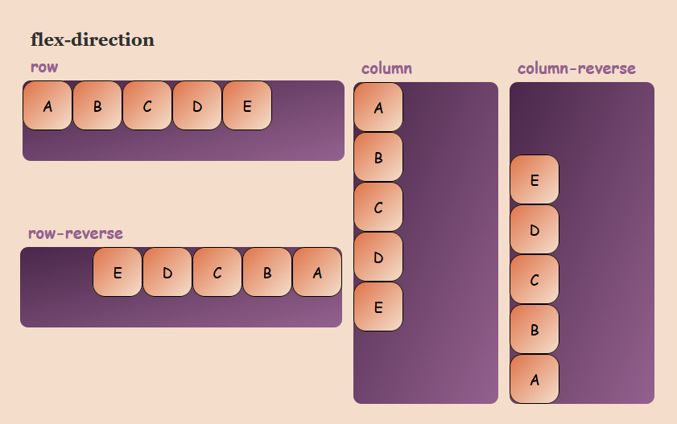
flex-direction: value;

Slide 19
Properties of Flex-Container (Parent)
justify-content: value;
Aligns flex items along the main axis (horizontally for row, vertically for column).
Values:
flex-start: Items are aligned to the start of the container.
flex-end: Items are aligned to the end of the container.
center: Items are centered along the main axis.
space-between: Equal space between items. space-around:
Equal space around items.

Slide 20
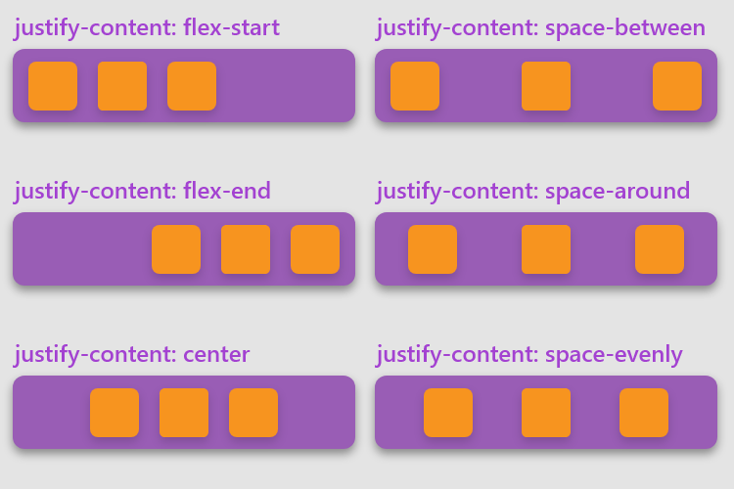
justify-content: value;

Slide 21
Properties of Flex-Container (Parent)
align-items: value;
Aligns items along the cross axis (vertically for row, horizontally for column).
Values:
stretch (default): Items stretch to fill the container.
flex-start: Items align to the top (for row) or left (for column).
flex-end: Items align to the bottom (for row) or right (for column).
center: Items align in the middle along the cross axis.

Slide 22
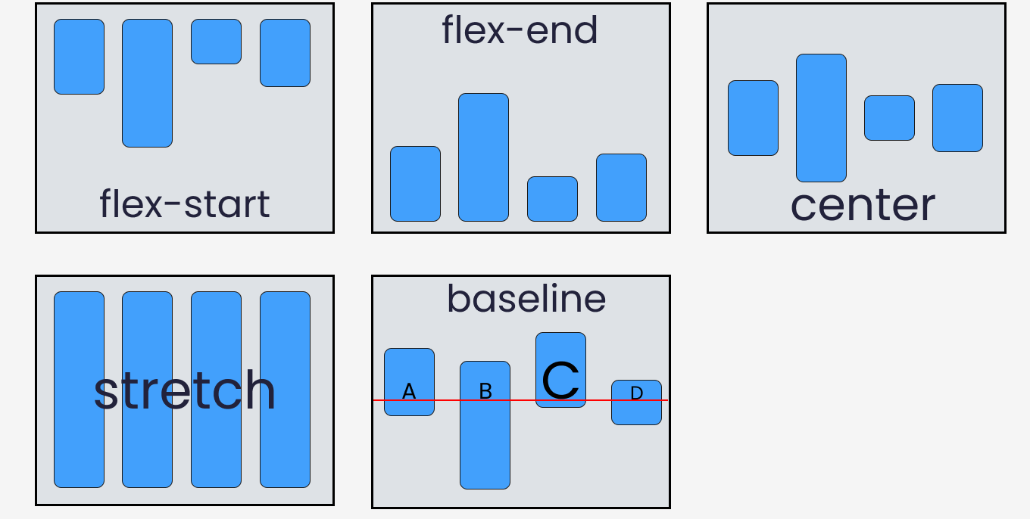
align-items: value;

Slide 23
Properties of Flex-Container (Parent)
flex-wrap: value;
Controls whether flex items are forced into a single line or can wrap onto multiple lines.
Values:
nowrap (default): Items are in a single line.
wrap: Items wrap onto multiple lines.
wrap-reverse: Items wrap in reverse order.

Slide 24
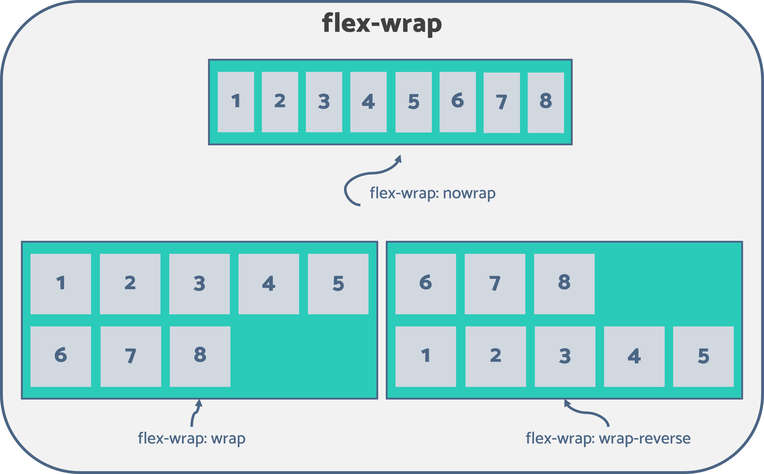
flex-wrap: value;

Slide 25
Properties of Flex-Container (Parent)
align-content: value;
Aligns multiple lines of flex items (used when there are multiple rows due to wrapping).
Values:
flex-start,
flex-end,
center,
space-between,
space-around,
stretch.

Slide 26
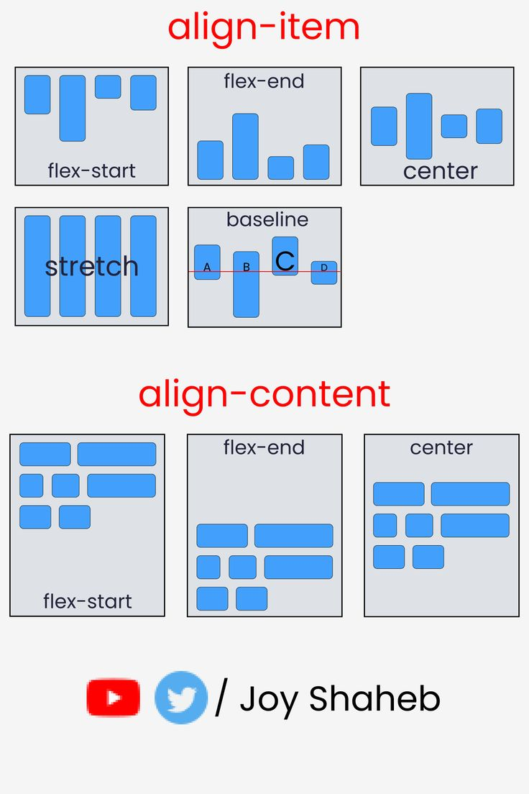
align-content: value;

Slide 27
Properties of Flex-Item (Child)
flex-grow: value;
Defines how much a flex item should grow relative to the other items.
Value (A number):
1 means the item can grow to fill available space.
0 (default) means it won't grow.
flex-shrink: value;
Defines how much a flex item should shrink relative to the other items.
Value (A number):
1 means it can shrink.
0 means it won't shrink.

Slide 28
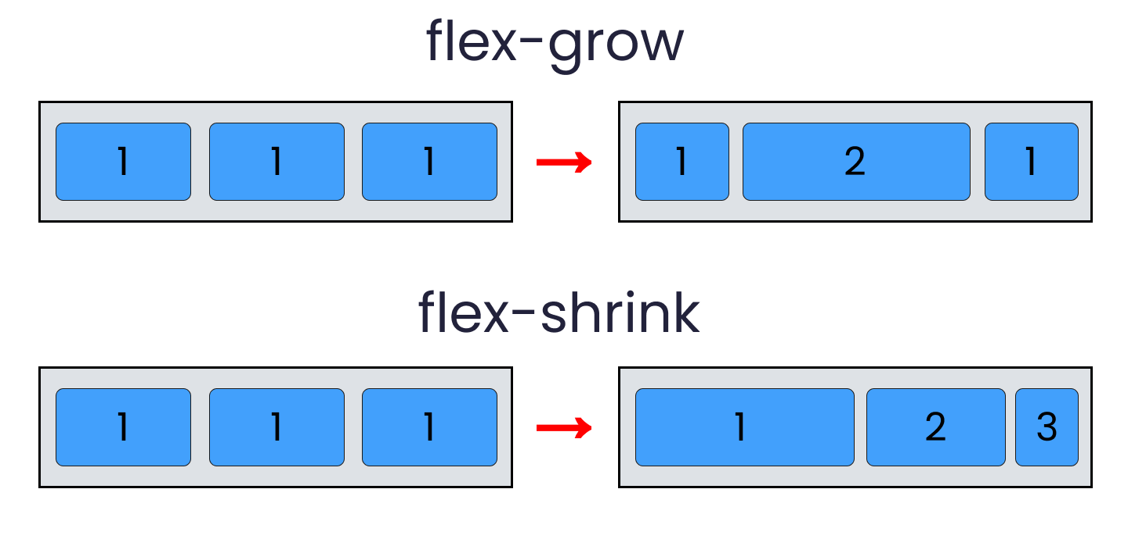
flex-grow: value; & flex-shrink: value;

Slide 29
Properties of Flex-Item (Child)
flex-basis: value;
Defines the initial size of a flex item before it grows or shrinks.
Value:
A length unit (e.g., 200px, 50%).
align-self: value;
Allows a flex item to override the align-items value for itself.
Values:
auto, flex-start,
flex-end, center,
baseline, stretch.

Slide 30
Grid (Important)
Advanced Cascading Styling Sheet (CSS)

Slide 31
Grid System
A two-dimensional system that allows you to design web layouts by defining both rows and columns.
It’s a powerful tool for creating complex and responsive layouts with ease, allowing you to position items within a grid.
And, control how they span across rows and columns.
Two components are necessary to make this work,
Grid Container: The parent element where display: grid; is applied.
Grid Items: The child elements inside the grid container that are arranged into rows and columns.

Slide 32
Grid System
.container {
display: grid;
/* Other grid properties to manage layout */
}
.item {
/* Grid items within the container */
}

Slide 33
Properties of Grid-Container (Parent)
display: grid;
This turns the container into a grid container, and its children become grid items.
grid-template-columns, grid-template-rows
Defines the number and size of the grid columns and rows.
You can define the size using units like px, %, fr (fraction), auto, etc.
.container {
grid-template-columns: 1fr 1fr; /* Two equal columns */
grid-template-rows: auto 300px; /* One row with automatic height, one with fixed height */
}

Slide 34
Properties of Grid-Container (Parent)
A 3-column layout where the first column is 200px, the second is 1fr (fractional unit), and the third is 2fr.
.container {
grid-template-columns: 200px 1fr 2fr;
}

Slide 35
Properties of Grid-Container (Parent)
gap: value;
Defines the space between grid items (like margin between grid cells).
You can set column-gap and row-gap separately, or use gap for both.
grid-template-areas: “values”;
Defines areas of the grid using named grid areas, allowing you to position grid items easily.
.container {
grid-template-areas: "header header header"
"sidebar content content"
"footer footer footer";
}
.header { grid-area: header; }
.sidebar { grid-area: sidebar; }
.content { grid-area: content; }
.footer { grid-area: footer; }

Slide 36
Properties of Grid-Container (Parent)
justify-items: value; align-items: value;
justify-items: Aligns items horizontally (left, right, center, stretch).
align-items: Aligns items vertically (top, bottom, center, stretch).
.container {
justify-items: center; /* Horizontally center items */
align-items: center; /* Vertically center items */
}

Slide 37
Properties of Grid-Container (Parent)
justify-content: value; align-content: value;
justify-content: Aligns the grid horizontally (left, right, center, space-between).
align-content: Aligns the grid vertically.
.container {
justify-content: center; /* Center the entire grid horizontally */
align-content: space-between; /* Spread the rows equally vertically */
}

Slide 38
Properties of Grid-Item (Child)
grid-column: value; grid-row: value;
Allows grid items to span multiple columns or rows.
Syntax: grid-column: start / end; or grid-row: start / end;
.item {
grid-column: 1 / 3; /* Span from column 1 to column 3 */
grid-row: 1 / 2; /* Span from row 1 to row 2 */
}

Slide 39
Properties of Grid-Item (Child)
grid-area: value;
Assigns a grid item to a named grid area (if using grid-template-areas).
.item {
grid-area: header; /* Place item in the 'header' area */
}

Slide 40
Properties of Grid-Item (Child)
justify-self: value; align-self: value;
Overrides justify-items and align-items for individual grid items.
justify-self: Controls horizontal alignment of the grid item.
align-self: Controls vertical alignment of the grid item.
.item {
justify-self: end; /* Align this item to the right in its grid cell */
align-self: center; /* Align this item to the center vertically */
}

Slide 41
Media Query
Advanced Cascading Styling Sheet (CSS)

Slide 42
Media Query for Different Screen Sizes
Media queries are the core feature of responsive design.
They allow you to apply different styles depending on the size of the user’s screen, orientation, or even device features.
Common Media Query Properties:
max-width: Target styles for screens smaller than or equal to a specific width.
min-width: Target styles for screens larger than or equal to a specific width.
orientation: Can target portrait (tall) or landscape (wide) screen orientations.

Slide 43
Media Query for Different Screen Sizes
/* Desktop screens */
@media (min-width: 1024px) {
body {
font-size: 24px;
}
}
/* Tablet screens */
@media (max-width: 768px) {
body {
font-size: 16px;
}
}
/* Mobile screens */
@media (max-width: 480px) {
body {
font-size: 8px;
}
}

Slide 44
Pseudo Selectors
Advanced Cascading Styling Sheet (CSS)

Slide 45
Pseudo Selectors
Also called pseudo-classes and pseudo-elements
Special keywords added to selectors
To style specific parts of an element or to define the element's state
Apply styles based on conditions or elements that aren't directly accessible via normal CSS selectors
There are two main types of pseudo-selectors:
Pseudo-classes
Pseudo-elements

Slide 46
1. Pseudo Classes
Target an element's state or a particular condition of an element
They don’t add content but rather apply styles based on the state of the element
States such as when it's being
hovered,
focused,
or when it's the first child in a container
or last child in a container

Slide 47
1. Pseudo Classes
:hover
When the user hovers over a link, it changes color to red
:focus
Targets an element when it is focused, such as a text input or button.
:nth-child(n)
Targets nth child of an element.
apply a red background to the second list item.
a:hover {
color: red;
}
input:focus {
outline: 2px solid blue;
}
li:nth-child(2) {
background-color: red;
}
:first-child & :last-child
Targets the first or last child of an element
:checked
Targets checkboxes or radio buttons that are checked
:disabled
Targets form elements that are disabled
p:first-child {
font-weight: bold;
}
input[type="checkbox"]:checked {
background-color: green;
}
button:disabled {
bg-c: gray;
}

Slide 48
2. Pseudo Elements
Targets specific parts of an element rather than its state
Style parts of an element or add content before or after it
Often used to apply styles to portions of an element's content

Slide 49
2. Pseudo Elements
::before
Inserts content before the content of the selected element
::after
Inserts content after the content of the selected element
::first-letter
Targets the first letter of the selected element's content
p::before {
content: "Note: ";
color: blue;
}
p::after {
content: “...end";
color: green;
}
p::first-letter { font-size: 2em;
color: red;
}
::first-line
Styles the first line of the selected element’s text
::selection
Styles the portion of the text that a user has highlighted or selected
p::first-line {
font-weight: bold;
}
::selection {
background-color: yellow;
color: black;
}

Slide 50
Combined Pseudo Selectors
You can combine pseudo-classes and pseudo-elements for advanced styling
a:hover::after {
content: " ( - click me)";
color: red;
}

Slide 51
Variables, Shadows and Effects
Advanced Cascading Styling Sheet (CSS)

Slide 52
Variables, Effects, Animation, Transforms
Property | Code Example | Short Description
CSS Variables | css<br>:root {<br> --main-color: #3498db;<br>}<br>.element {<br> background-color: var(--main-color);<br>}<br> | Stores a reusable color value for consistent styling.
Box Shadow | css<br>.box {<br> width: 200px;<br> height: 200px;<br> box-shadow: 5px 5px 15px rgba(0, 0, 0, 0.3);<br>}<br> | Adds a shadow effect below and to the right of the box.
Text Shadow | css<br>.title {<br> font-size: 24px;<br> text-shadow: 2px 2px 4px rgba(0, 0, 0, 0.5);<br>}<br> | Applies a shadow effect to text, giving it depth.
Transition | css<br>.button {<br> background-color: blue;<br> transition: background-color 0.3s;<br>}<br>.button:hover {<br> background-color: darkblue;<br>}<br> | Smoothly changes the background color on hover.
Animation | css<br>@keyframes fadeIn {<br> from {opacity: 0;}<br> to {opacity: 1;}<br>}<br>.fade {<br> animation: fadeIn 1s;<br>}<br> | Fades in an element from invisible to visible.
Transform | css<br>.card {<br> transition: transform 0.3s;<br>}<br>.card:hover {<br> transform: scale(1.1);<br>}<br> | Scales up the element when hovered over.
Combined Effects | css<br>.image {<br> transition: transform 0.3s, box-shadow 0.3s;<br>}<br>.image:hover {<br> transform: scale(1.1);<br> box-shadow: 0 10px 20px rgba(0, 0, 0, 0.3);<br>}<br> | Combines scaling and shadow effects on hover.

Slide 53
Important Shortcuts
If you don’t have any idea about CSS colors, save this Coolors - The super fast color palettes generator!
If you don’t have any idea about CSS grid system, save this Grid by Example - Usage examples of CSS Grid Layout
If you don’t have any idea about CSS animations, save this Animista - On-Demand CSS Animations Library

Slide 54
The End
Any Questions?

